Slide 1


Air Quality Monitoring Dashboard
Acharya Institute Of Graduate Studies
Submitted by,
Ujjual K C
Parthasarathy A S
Ramseena N
Vinayak P T

Slide 2
Problem Statement
Brief Overview:
This case study focuses on building an interactive Air Quality Dashboard that allows users to visualize and analyze air quality data from different locations. The project aims to help users monitor Air Quality Index (AQI) and pollutant levels, providing insights into air pollution trends using a user-friendly interface built with Streamlit and visualization tools like Plotly.
Key Objectives:
Data Preprocessing: Handle missing values, remove outliers, and categorize AQI levels.
Interactive Visualizations: Use Plotly to create interactive charts for better insights.
User Customization: Provide filter options for cities, pollutants, and date ranges.
Correlation Analysis: Examine relationships between AQI and pollutants.
City Comparisons: Compare AQI across different locations.
Downloadable Reports: Allow users to download filtered data in CSV/Excel formats.
Source :
www.freepik.com/

Slide 3
Dataset Overview
Dataset Description:
Dataset Name: Air Quality Data
Source: Provided CSV file (air_qualitydata.csv)
Size: Varies based on data collected.
Key Features: Includes columns such as City, Date, AQI, PM2.5, PM10, NO2, SO2, CO, O3, Benzene, and more.
Data Preprocessing:
Missing values in AQI are dropped.
Other missing values are replaced with the column mean.
Outliers are handled using Interquartile Range (IQR) method.
AQI values are categorized into Good, Satisfactory, Moderate, Poor, Very Poor, and Severe.
Source :
www.freepik.com/

Slide 4
Methodology
Approach:
Setting up the Environment: Install necessary Python libraries.
Loading and Preprocessing Data: Handle missing values, remove outliers, and categorize AQI levels.
Building the Streamlit Dashboard:
Sidebar filters for cities, AQI range, and pollutants.
Tabs for AQI overview, pollutant analysis, correlation, and city comparisons.
Visualizing Data with Plotly: Generate histograms, bar charts, scatter plots, and correlation matrices.
Providing Downloadable Reports: Allow users to download filtered data in CSV/Excel formats.
Source :
www.freepik.com/

Slide 5
Algorithms & Libraries Used:
pandas(Data handling)
numpy(Numerical operations)
matplotlib & seaborn(Basic visualization)
plotly.express & plotly.graph_objects(Interactive visualizations)
sklear.impute(Handling missing values)
streamlit(Building the dashboard)

Slide 6
Source Code:
https://github.com/Law-chaos/Air_Quality_Dashboard/blob/4ca60e2447e6d42dc43b662311821486d978177d/AQI_app.py

Slide 7
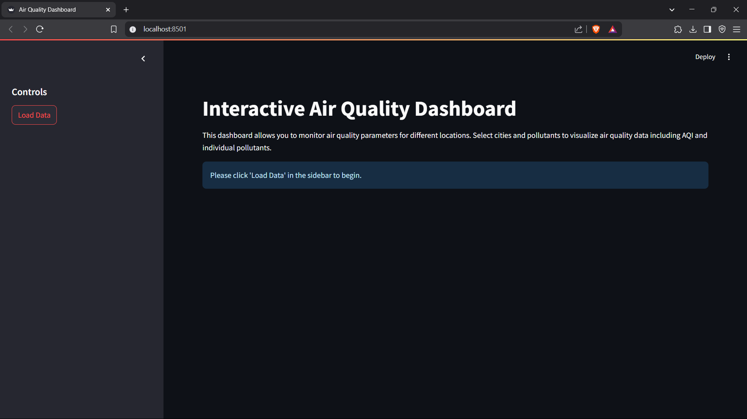
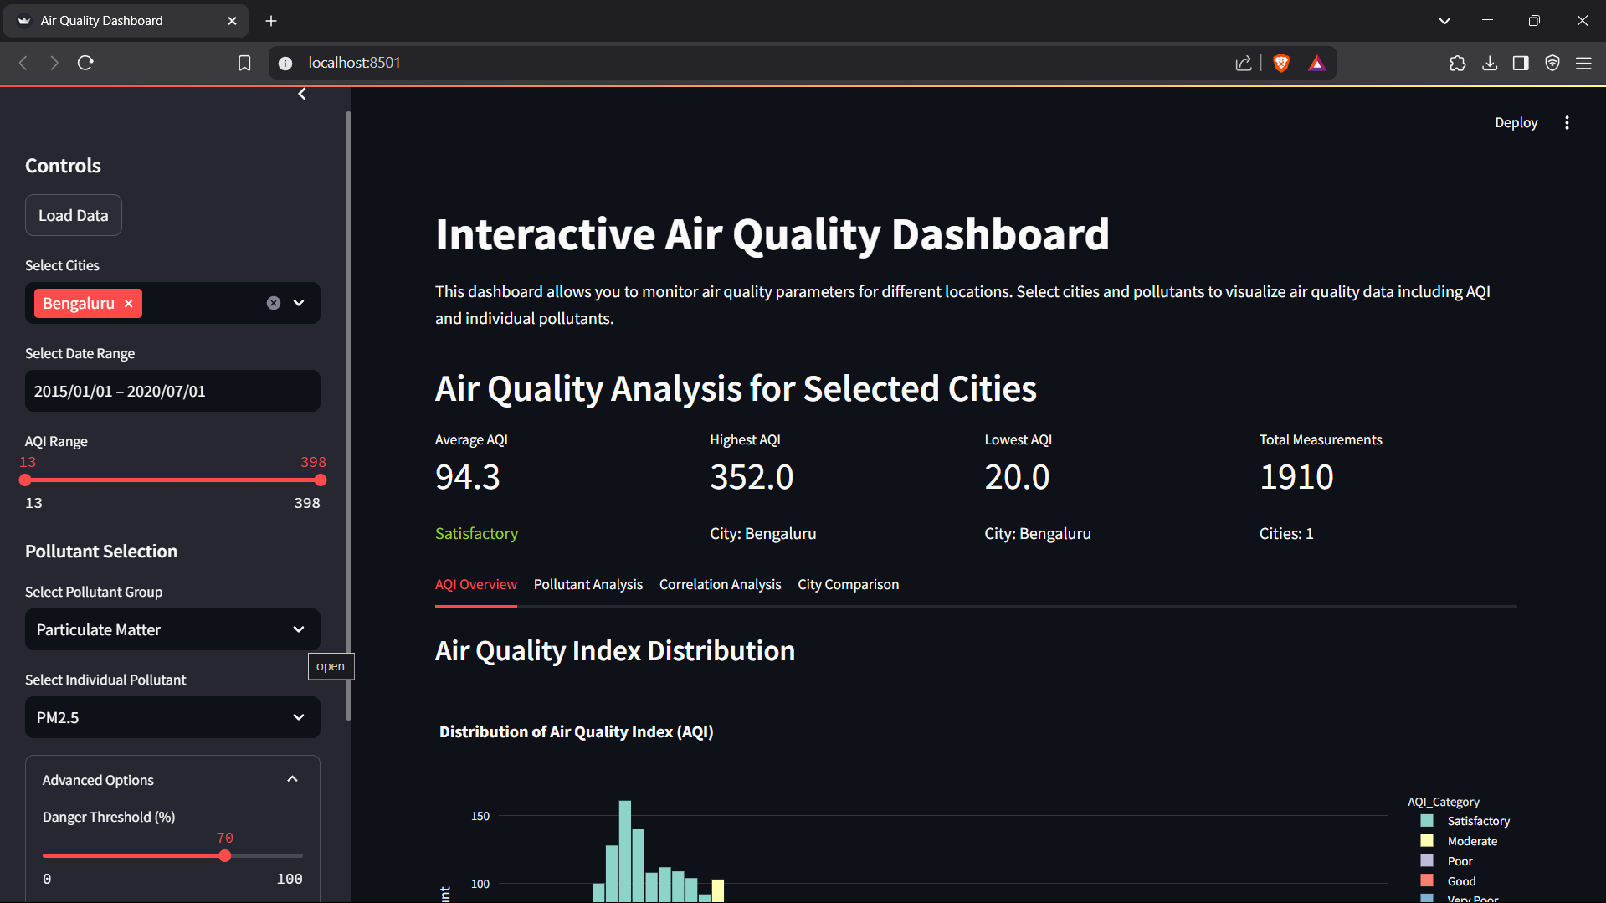
Ouput Screens
Main Dashboard
👇
After Loading Data

Slide 8
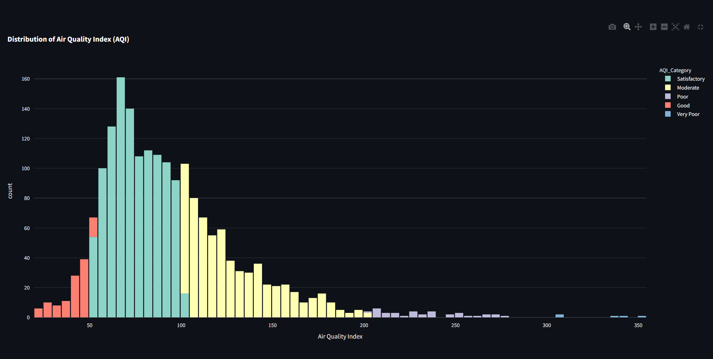
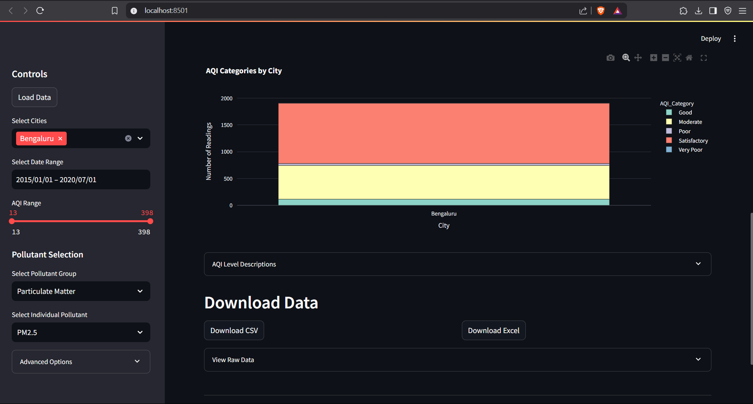

Slide 9
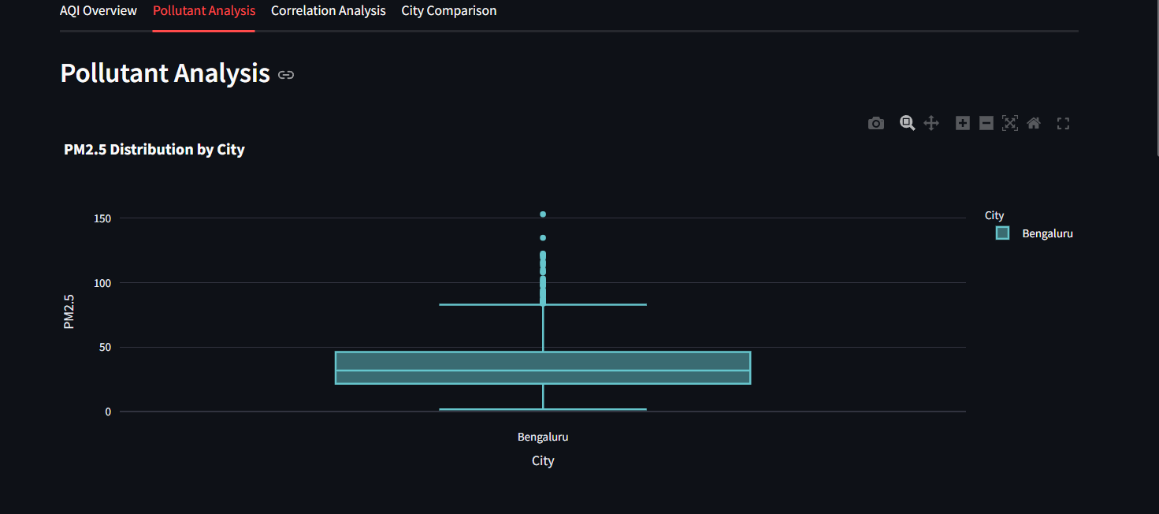
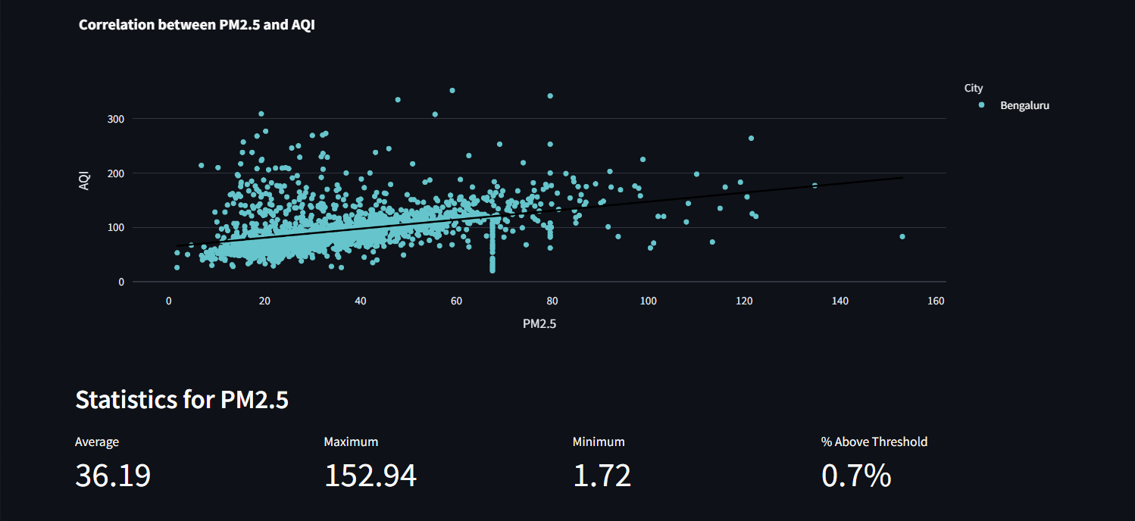
Pollutant Analysis

Slide 10
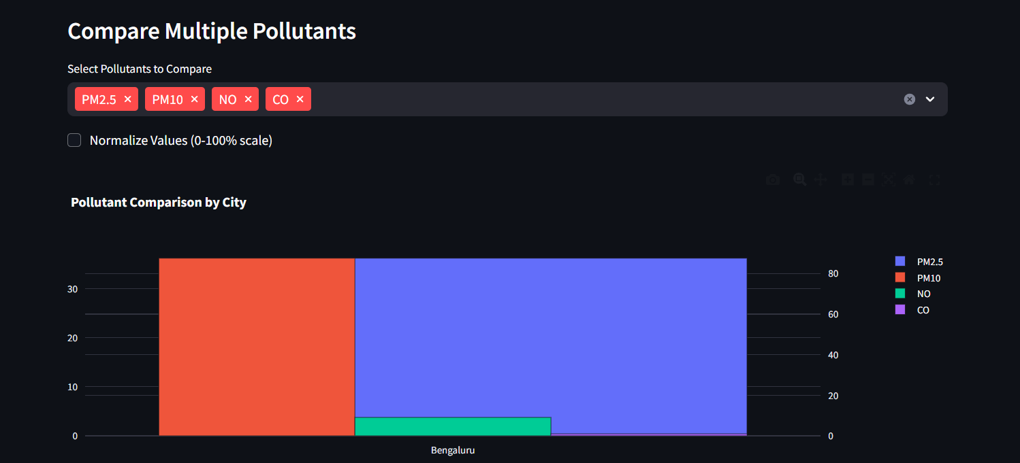
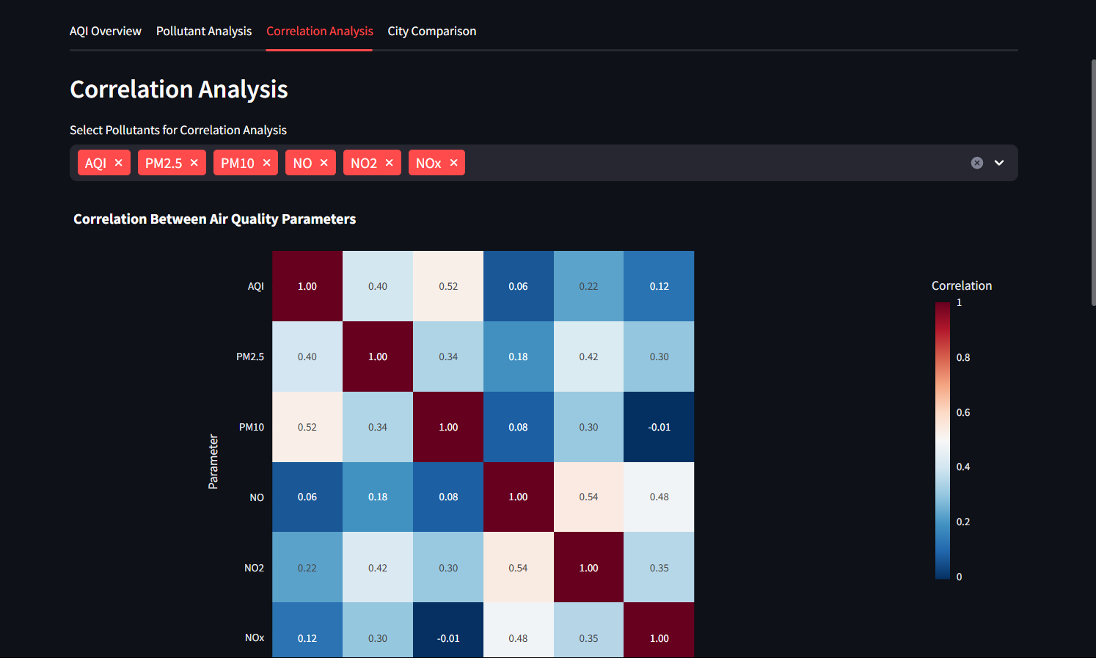
Correlation Analysis

Slide 11
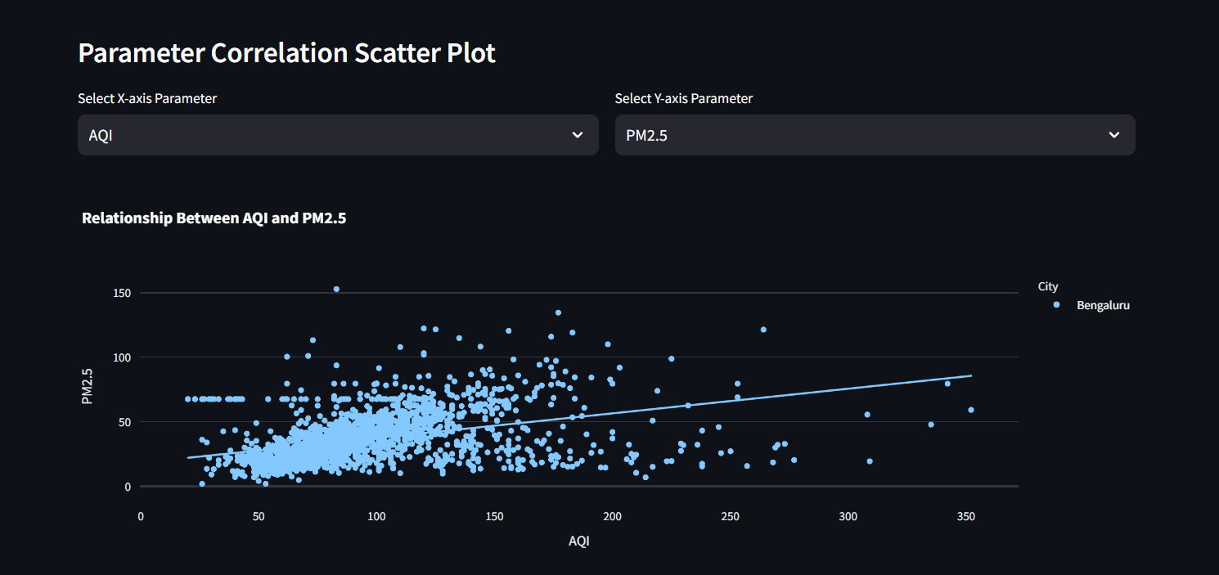
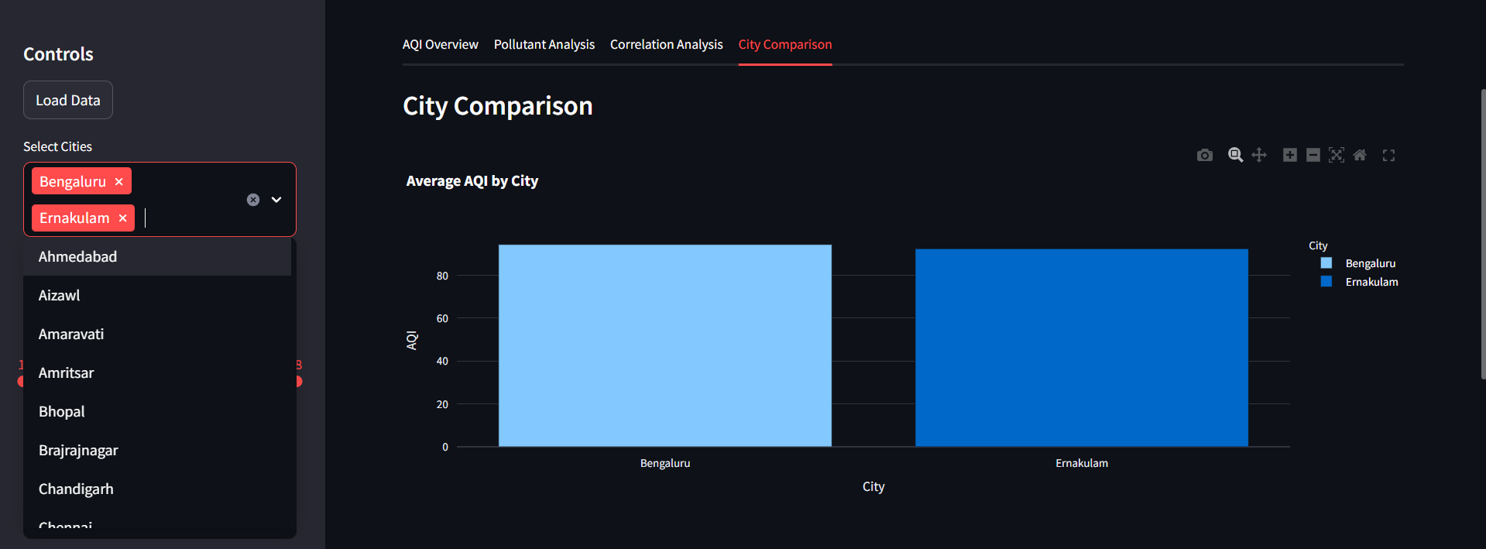
City Comparison

Slide 12
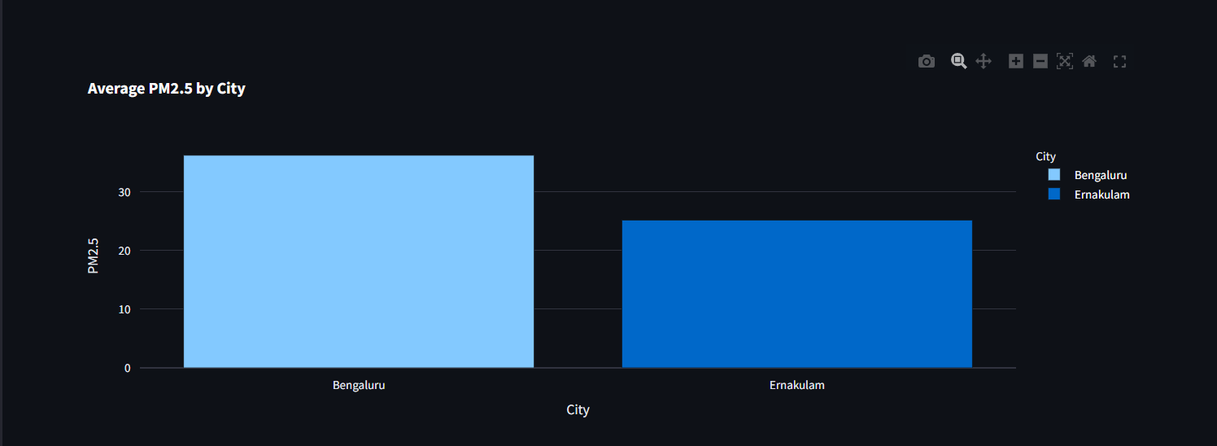


Slide 13

Conclusion
Summary:
The Air Quality Monitoring Dashboard effectively visualizes AQI and pollutant trends in an interactive and user-friendly manner. Users can analyze data, compare pollution levels across cities, and download reports for further research.
Future Work:
Integrate Real-Time Data from APIs.
Include Predictive Analysis using Machine Learning models.
Improve User Interface with more customization options.
Source :
www.freepik.com/

Slide 14
References
Streamlit Documentation: https://docs.streamlit.io/
Plotly Documentation: https://plotly.com/python/
GitHub Link
https://github.com/Law-chaos/Air_Quality_Dashboard.git

Slide 15
Thank You
Notes:
Thank You !!

